Slide 1
Ecommerce
Application
COMPSCIX446
Christina Valen
2026-Oct-26

Slide 2
Overview
A simple modern web application utilizing flask, python, and AWS relational database service.
Built to replicate a shopping site with basic role based access, stock updating, and cart/order handling.
Ideal customer would be someone looking for minimal interfaces and that does not plan on receiving items in return for submitting an order.

Slide 3
Features
Authorizations: Certain actions require log-in or administrative access.
Product handling: Stock, price, and description can be edited if accessed by an admin. Products are decremented when an order is submitted. Actions are taken to prevent adding an out-of-stock item to cart and including items in cart that are not available.
Cart:
Order:

Slide 4
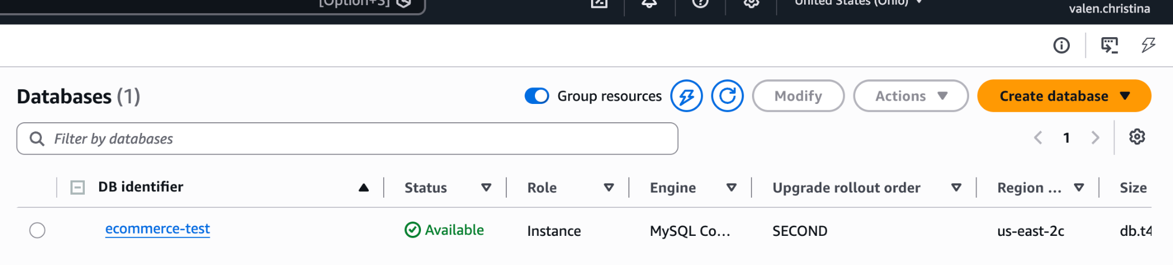
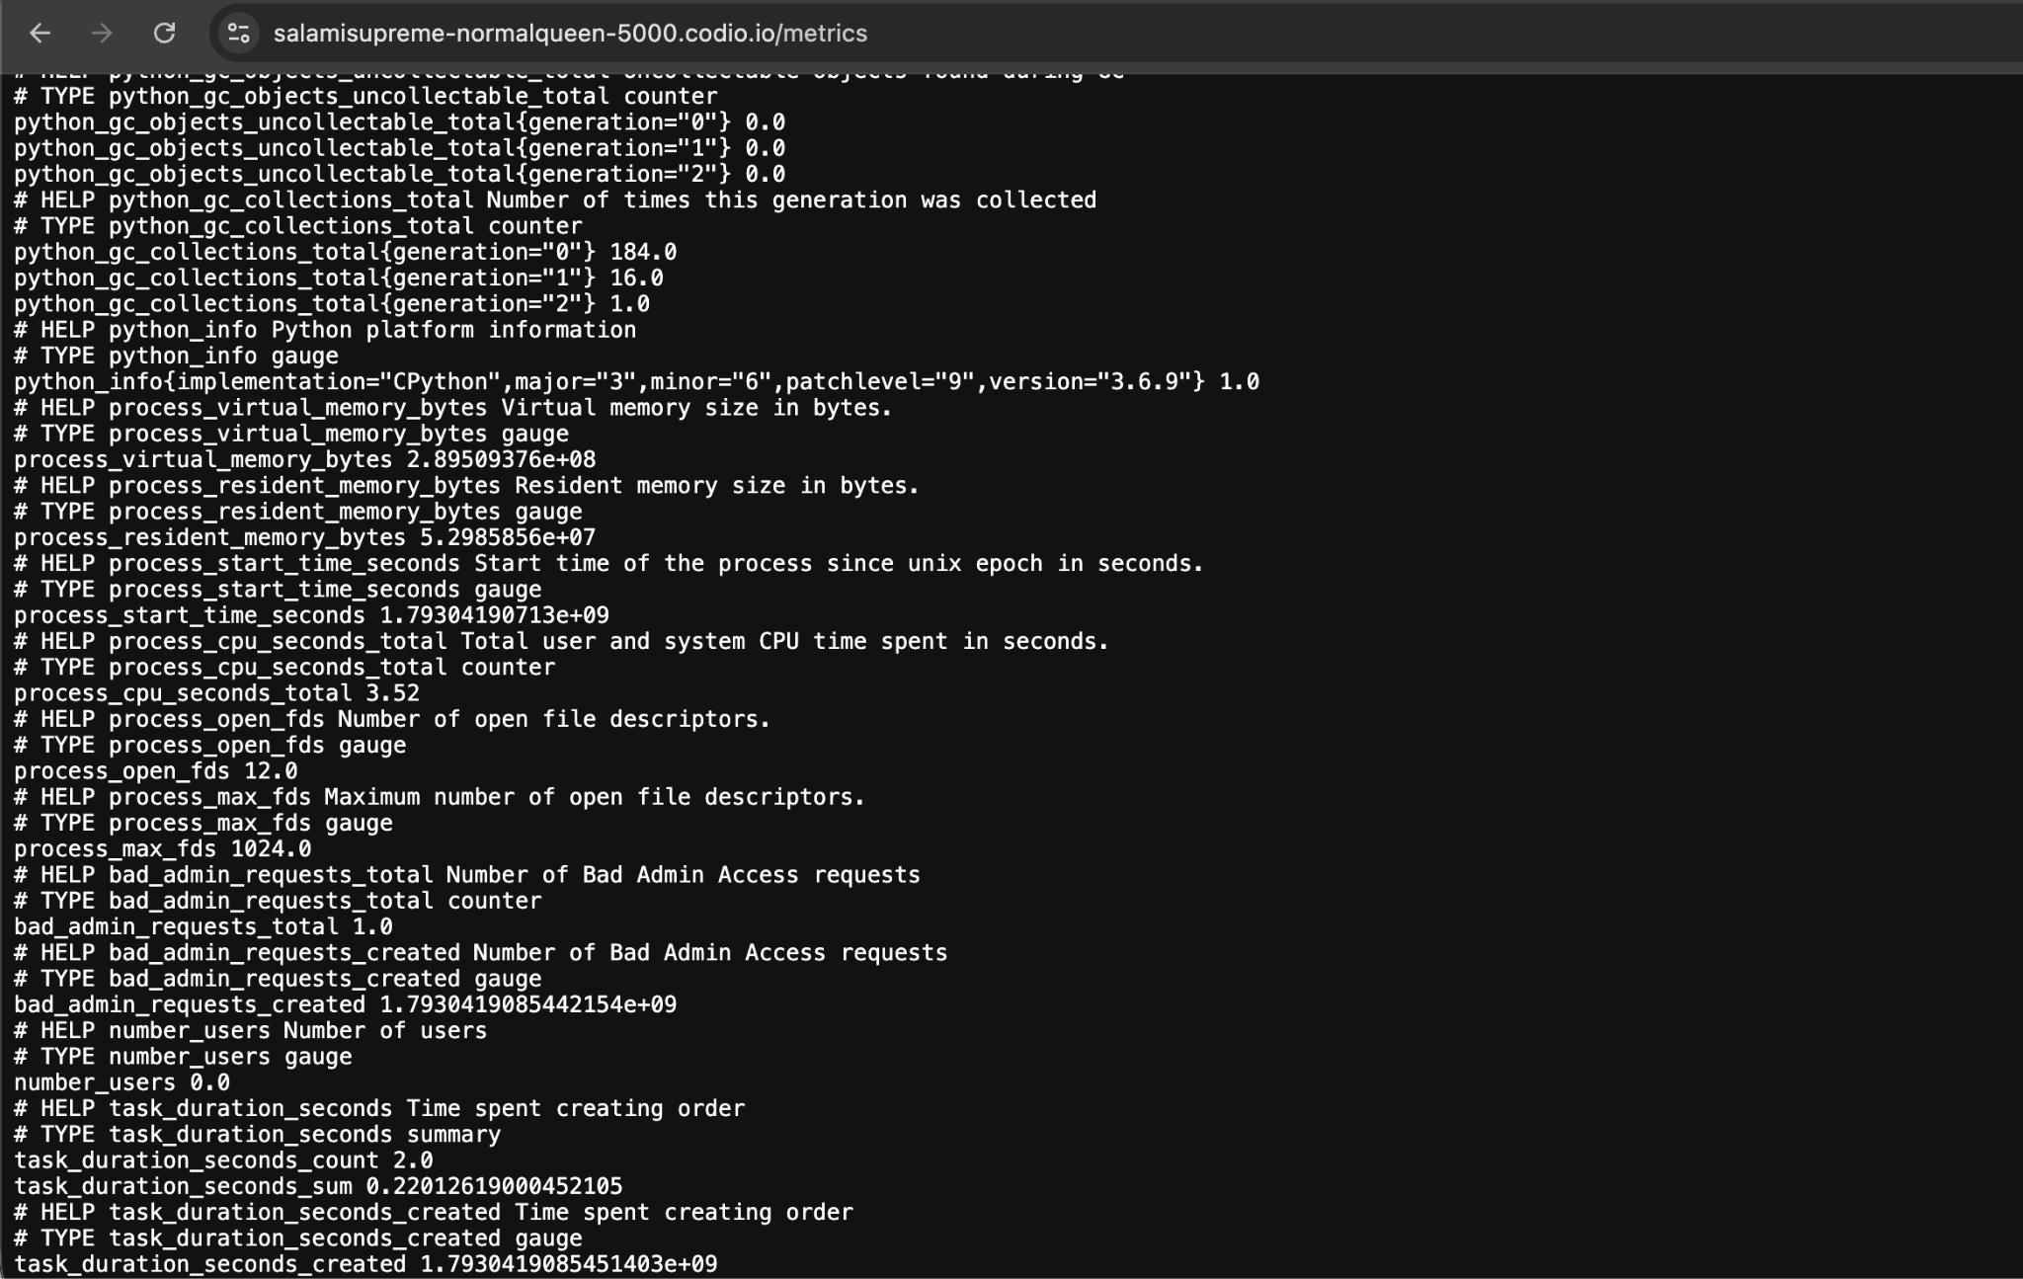
Integrations
AWS relational database used.
EC2 bucket for images.
Prometheus logging available on
Port 5000/metrics

Slide 5
Drawbacks
SQL databases were developed on an as-needed basis. Little forethought was put into structure resulting in redundancies and inefficiencies.
Unsuccessful logins will not indicate if the problem entry is the email or password. There is no way to retrieve a forgotten password or reset a password.
The carts database is horribly inefficient and would likely bloat and cause memory issues in any actual use-case.
Most obviously, as this is intended to be a toy application, there is no payment handling and address information is not requested at any point from the user.

